Slide 1
Module 9: Association Studies
Hannah Carter
Department of Medicine
March 3, 2016

Slide 2
Outline
Day 1:
Population genetics primer
Genome wide association studies
Population substructure
Exercises
Day 2:
Quantitative Genetics & Missing heritability
Imputation & haplotypes
Exome wide association studies
Exercises

Slide 3
Quantitative Genetics
The classical quantitative genetics model introduced by Ronald Fisher (1918)
Y = G + E,
Y is the phenotypic value
G is the genetic contribution
E is the environmental contribution
G is the combination of all genetic loci that influence the phenotypic value and E consists of all non-genetic factors that influence the phenotype
For convenience, exp(E) is generally taken to be 0 so that the mean genotypic value is equal to the mean phenotypic value, i.e., E (Y ) = E (G )

Slide 4
Quantitative Genetics
Consider a single locus.
Fisher modeled the genotypic value G with a linear regression model (least squares) where the genotypic value can be partitioned into
an additive component (A) and
deviations from additivity as a result of dominance (D)
and G=A+D
Y=A+D+E

Slide 5
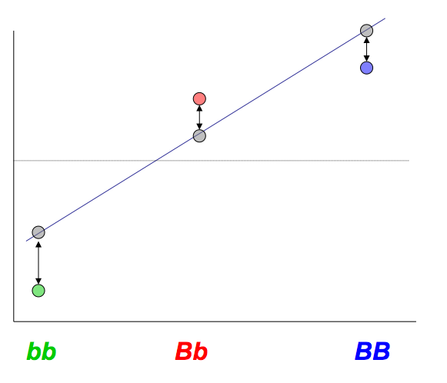
Linear Regression Model for Genetic Values
Imagine we could measure the contribution of a specific genotype to a trait independent of environment
Mean trait
value
Contribution of genotype G to a trait
Var(Y) = Var (G) = Regression Variance + Residual Variance = Additive Variance + Dominance Variance

Slide 6
Components of Genetic Variance
Variance is a property of a population
In least squares regression, the residuals are orthogonal to the regression line, and thus COV(A,D) = 0
σ²_{A} Additive genetic variance is the genetic variance associated with the average additive effects of alleles
σ²_{D} Dominance genetic variance is the genetic variance associated with the dominance effects.

Slide 7
Broad Sense Heritability
Heritability of a trait: Y = G + E
The broad-sense heritability is defined to be
H² = σ_{G}^{2 /} σ_{Y}²
H₂ is the proportion of the total phenotypic variance that is due to all genetic effects (additive and dominance)
There are a number of methods for heritability estimation of a trait.

Slide 8
Narrow sense heritability
Heritability of a trait: Y = G + E = A + D + E
The following ratio of variance components
h ² = σ _{A}^{2 /} σ_{Y}²
is defined to be the narrow-sense heritability (or simply heritability)
h² is the proportion of the total phenotypic variance that is due to additive effects.
Heritability can also be viewed as the extent to which phenotypes are determined by the alleles transmitted from the parents.

Slide 9
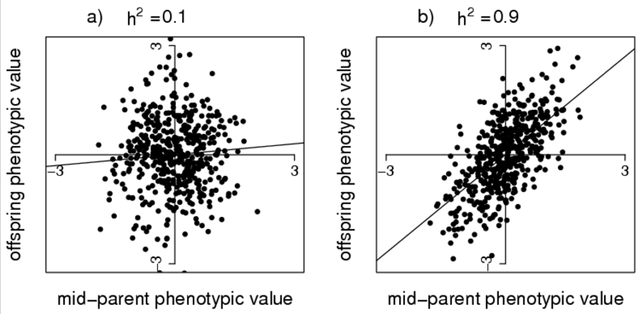
Estimating heritability
A) Regress the offspring phenotype on the average phenotype of the parents, or regress the phenotypes of siblings on one another
Note:For one parent – one offspring regression, you take 2x the slope, and for midparent – offspring regression, you take 1x the slope.
B) Compare the phenotypic concordance of monozygotic (MZ, identical) twins versus dizygotic (DZ, fraternal) twins
- Falconer’s formula: 2(r_{mz} – r_{dz})
http://www.nature.com/scitable/topicpage/estimating-trait-heritability-46889
Notes:
Intuition – Mid parent phenotype represents 100% of genetic material, while 1 parent – offspring and sib-sib represent only 50% of the genetic material
r = pearson’s correlation coefficient

Slide 10
Estimating the variance explained
So you ran a GWAS and you found a SNP…
What fraction of the heritability does your SNP explain?
In regression, the R² coefficient of determination is a statistical measure of how well the regression line approximates the real data points. Thus R² in a linear regression of genotype on phenotype can be interpreted as an estimate of the proportion of phenotypic variance explained by the SNP(s)
Note that depending on how the model is constructed, the slope may be determined by multiple covariates. In that case, you need to estimate the proportion of R² attributable to the term of interest

Slide 11
Coefficient of Determination
Simple linear regression:
Multiple linear regression:
Want to understand the proportion of variance that is attributable to a particular covariate
ANOVA: Reports SS contribution for each term
Notes:
y-bar is the expected phenotypic value
yi is the observed phenotypic value for the ith individual
fi is the predicted or fitted phenotypic value for the ith individual

Slide 12
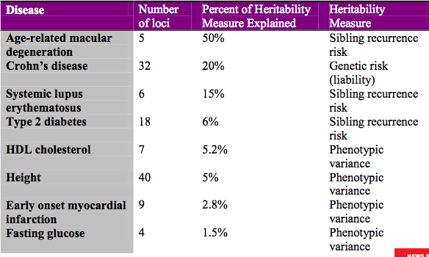

Missing heritability
GWAS effects sizes are typically small
OR 1.1~1.3
% variance explained for quantitative traits < 1%

Slide 13
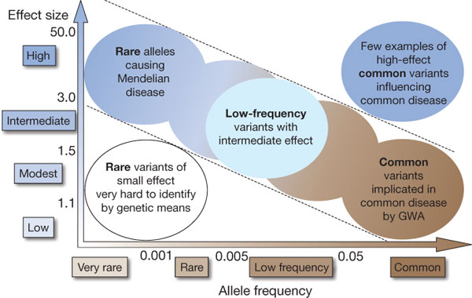
Where’s the heritability?
Common disease rare variant (CDRV) hypothesis: diseases due to
multiple rare variants with intermediate penetrances (allelic heterogeneity)?
Many more
of these?
Manolio et al., 2009
Notes:
Architecture of genetic disease

Slide 14
Possible causes of missing heritability
Common variants that don’t meet statistical threshold required for publication
More are found than expected by chance => Some are likely real
SNPs on chip may not be close enough to causal variant, or effect sizes may just be very small
Rare variants
GWAS cannot detect associations for variants with MAF < 1%
Effect sizes larger than common variants but not large enough for familial aggregation
Epistatic interactions
failure to account for interactions inflates estimate of h²
Variants other than SNPs
Common structural variants are likely captured by LD with common SNPs but rare SVs could account for part of the missing heritability
Epigenetics (imprinting)
Hard to detect association if presence of allele AND parental effects combine to modify risk – would cause contribution to heritability to be underestimated
Robustness (Biological buffering)
In some individuals, low robustness may expose deleterious variants
Regions of the genome that can’t be sequenced (repetitive)

Slide 15
Determining the role of common variation
GCTA: Mixed effects model incorporating a genetic relationship matrix as a random effect
Fit phenotype to all SNPs at once
Estimate the total phenotypic variance explained by ALL SNPs
Can also break down by individual chromosomes

Slide 16
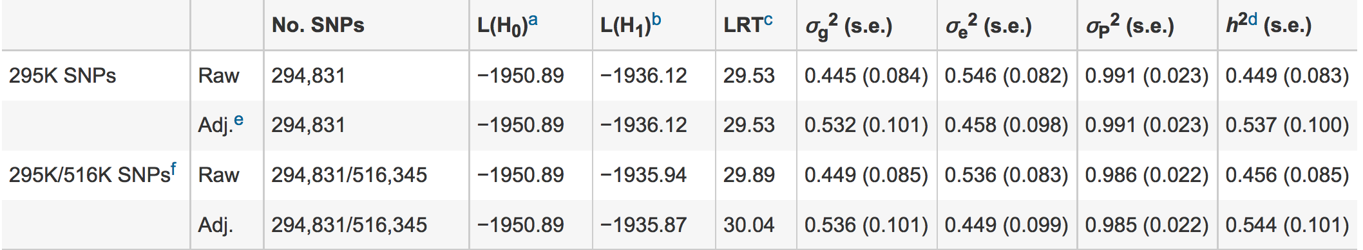
Heritability of Height
Estimates based on parent-offspring analysis suggest h² = 80%
“Recent GWASs on tens of thousands of individuals have detected ~50 variants that are associated with height in the population, but these in total account for only ~5% of phenotypic variance”
“One reason why the SNPs do not explain the full estimated heritability is that the SNPs on the arrays are not in complete LD with causal variants. “
Nature Genetics 42, 565–569 (2010) doi:10.1038/ng.608

Slide 17
Running GCTA
Commandline tool
Runs on PLINK binary files
Two main steps:
Estimate genetic relationship matrix (GRM)
Data QC: Drop markers not in HWE & related individuals
gcta64 --bfile test --autosome --make-grm --out test
Use REML (REstricted Maximum Likelihood) method to estimate proportion of variance explained
gcta64 --reml --grm test --pheno test.phen --out test

Slide 18
Imputation

Slide 19
Imputation: In Silico Genotyping
In families, there are long stretches of shared chromosome
In unrelated individuals, shared stretches are much shorted
Identify stretches of shared chromosome between individuals
Infer intervening genotypes by contrasting samples typed at a few sites with individuals that have denser genotypes (so called reference panel)

Slide 20
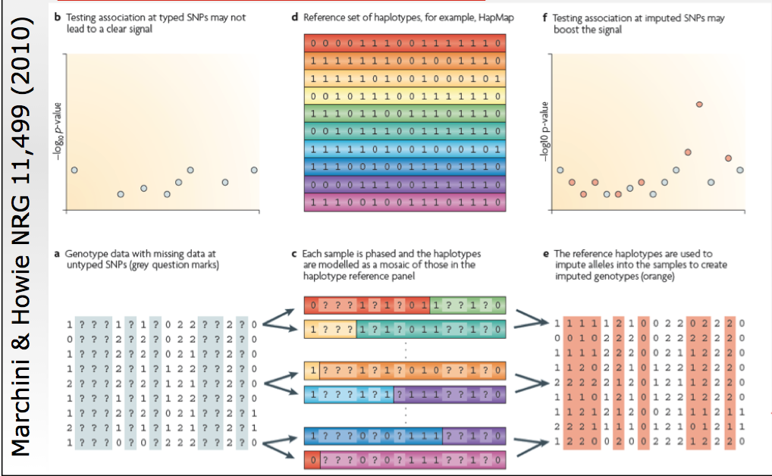
Imputation Overview

Slide 21
Implementation
A Markov Model is usually used to model each haplotype, conditional on all others
At each position, we assume that the haplotype being modeled copies the template haplotype
Since each individual has two haplotypes, they copy 2 template haplotypes

Slide 22
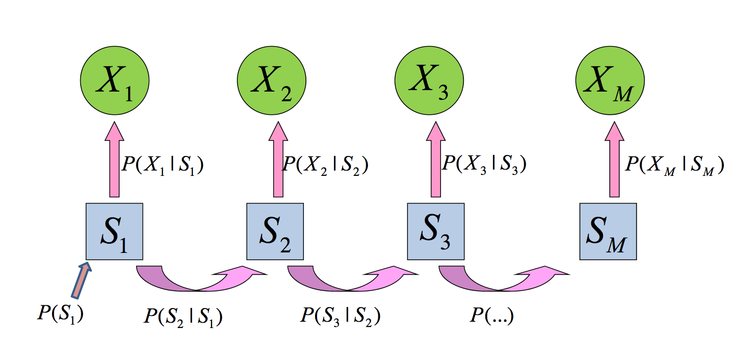
Markov Model
Emitted value: Most probably allele pair given state
Hidden state: Most probably haplotype pair given previous state
The Markov Model models the probability of an allele at a given SNP conditional on the state at the previous SNP. Model parameters (transition and emission probabilities) are estimated from the data.

Slide 23
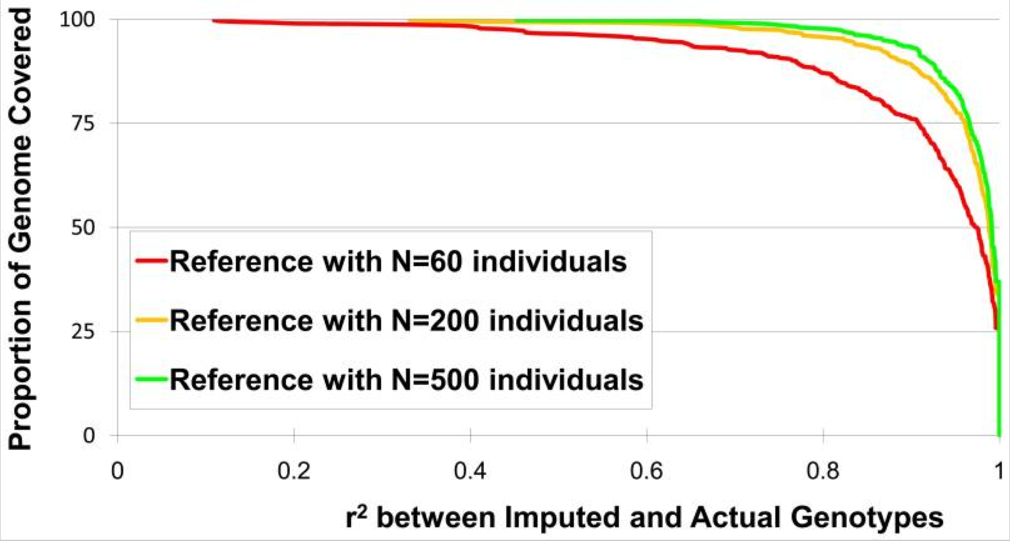
Accuracy of Imputation
Annu Rev Genomics Hum Genet. 2009; 10: 387–406. doi: 10.1146/annurev.genom.9.081307.164242
For any given r² threshold, the results illustrate the proportion of markers whose genotypes can be imputed with equal or greater accuracy. The results illustrate how the proportion of markers whose genotypes are recovered accurately (with high r² between imputed and actual genotypes) increases with larger reference panels.

Slide 24
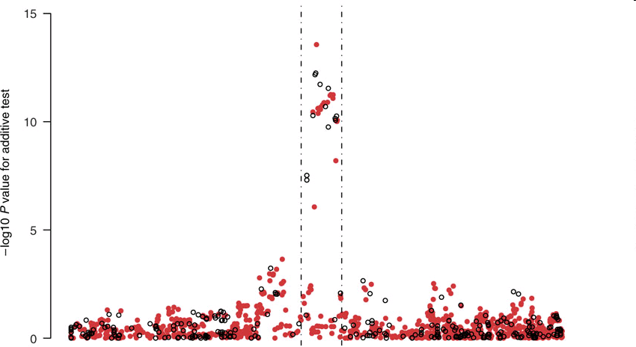
Imputation Application
TCF7L2 gene region & T2D from the WTCCC data
Observed genotypes black
Imputed genotypes red.
Imputed SNP more significant than typed SNP!
Chromosomal Position
Marchini Nature Genetics2007
http://www.stats.ox.ac.uk/~marchini/#software
Notes:
24
The upper part of plot shows the -log10P value for the additive model versus a model of no association. The P values were calculated using called genotypes (black circles) and imputed genotypes (red circles), called at a threshold of 0.9. The middle panel shows a measure of certainty for each SNP, which is defined as the average maximum posterior genotype call probability. The lower panel shows the fine-scale recombination rate across the region (blue) and the cumulative recombination rate measured away from the most highly associated genotyped SNP (orange). The vertical dashed lines on the plot delineate the main region of association. The largest -log10P value at a genotyped SNP (rs4506565) is 12.25, whereas the largest -log10P value at an imputed SNP (rs7903146) is 13.57.

Slide 25
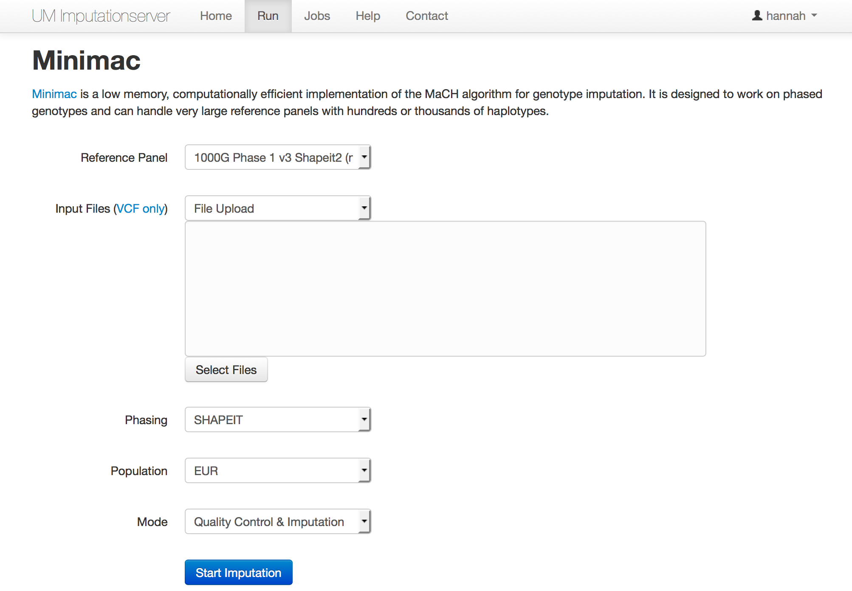
Michigan Imputation Server
https://imputationserver.sph.umich.edu/

Slide 26


Slide 27
Haplotypes
What are haplotypes?
A set of SNPs on a single chromatid that are statistically associated
6 SNP Haplotype w/ 4 common SNP combinations
T/C A/G A/G A/G A/G A/G
T A G G G A
36.4%
C A G G G A
2.27%
C A G A A G
1.57%
C G A A A G
56.9%

Slide 28
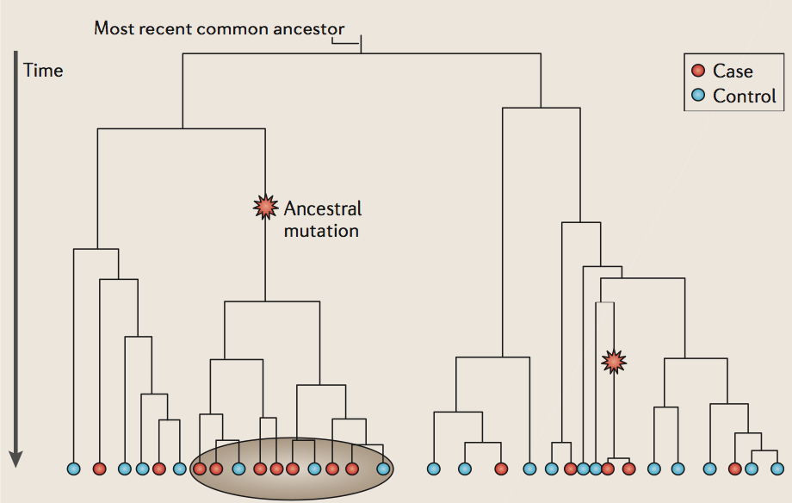
Why Use Haplotypes?
Haplotypes capture fine population structure at a locus and therefore have better power to detect rare variant associations than common SNPs
Can group individuals by branch

Slide 29
Inferring Haplotypes
A variety of tools exist
Beagle and CHIAMO are popular
Simultaneous phasing, imputation and haplotype inference

Slide 30
Beagle Method
Uses a localized cluster model implemented as an acyclic graph to represent haplotypes
The acyclic graph also defines a Markov Model that can be used to sample haplotypes or identify the most likely haplotype pair for an individual given their genotypes
Phasing is performed by iteratively sampling haplotype pairs and updating the localized cluster model

Slide 31
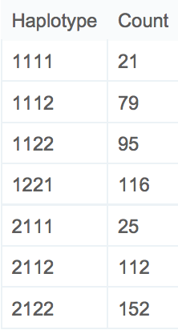
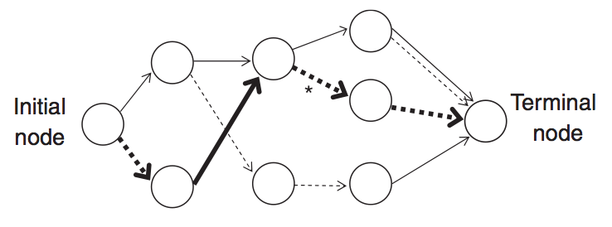
Beagle Localized Haplotype Cluster Example
Phased 4 marker combinations
Corresponding graphical model
A₁,A₂
A₁
A₂
A₂
A₂
SNP1
SNP2
SNP3
SNP4
SNP5
Bold path corresponds to 2122
* Represents both 1122 and 2122 since those haplotypes both traverse the edge

Slide 32
Beagle Applied
Use PLINK to format data for Beagle
Apply beagle to each chromosome separately to generate graphs and phased genotypes
Java –jar beagle.jar unphased= phased=(optional) markers= missing= out=
Utility provided to convert phased genotypes to VCF format
Separate utility files available via older Beagle website: https://faculty.washington.edu/browning/beagle/b3.html
Use to extract haplotype sequences and to generate diallelic haplotype “pseudomarkers” that represent individuals with a particular haplotype versus those that don’t have it

Slide 33
Association Testing with Haplotypes
If encoded as di-allelic markers (one vs rest) can apply standard association methods
Omnibus testing
Include all possible haplotypes at once
Omnibus:
y=β₀+β₁H₁+β₂H₂+β₃H₃+β₄H₄+e
1 versus Rest:
y=β₀+β₁H₁+e
y=β₀+β₁H₂+e
y=β₀+β₁H₃+e
y=β₀+β₁H₄+e
6 SNP Haplotype w/ 4 common SNP combinations
T/C A/G A/G A/G A/G A/G
T A G G G A
36.4%
C A G G G A
2.27%
C A G A A G
1.57%
C G A A A G
56.9%

Slide 34
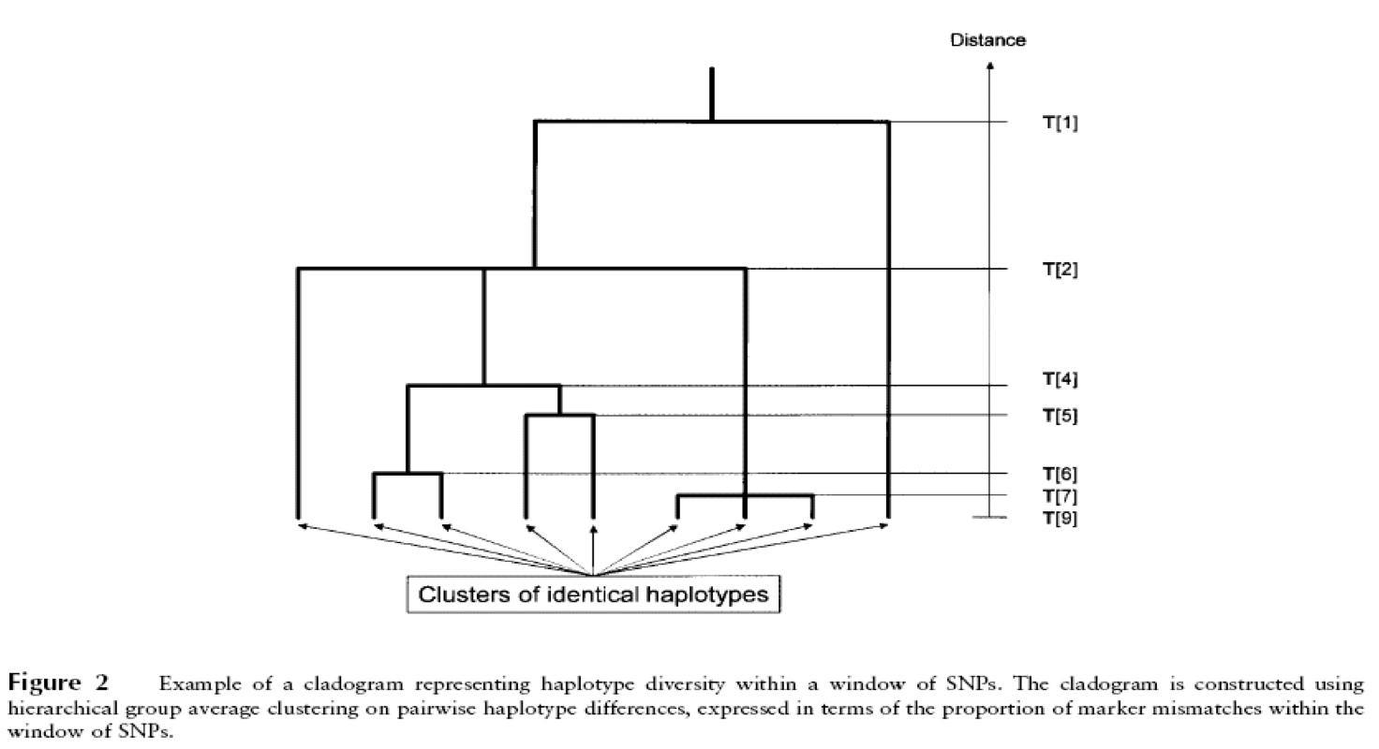
Haplotype Association Analysis
If you have some idea of the haplotype structure and where different groups might have diverged, you can test various hypotheses (e.g. group samples by branch in cladogram)

Slide 35
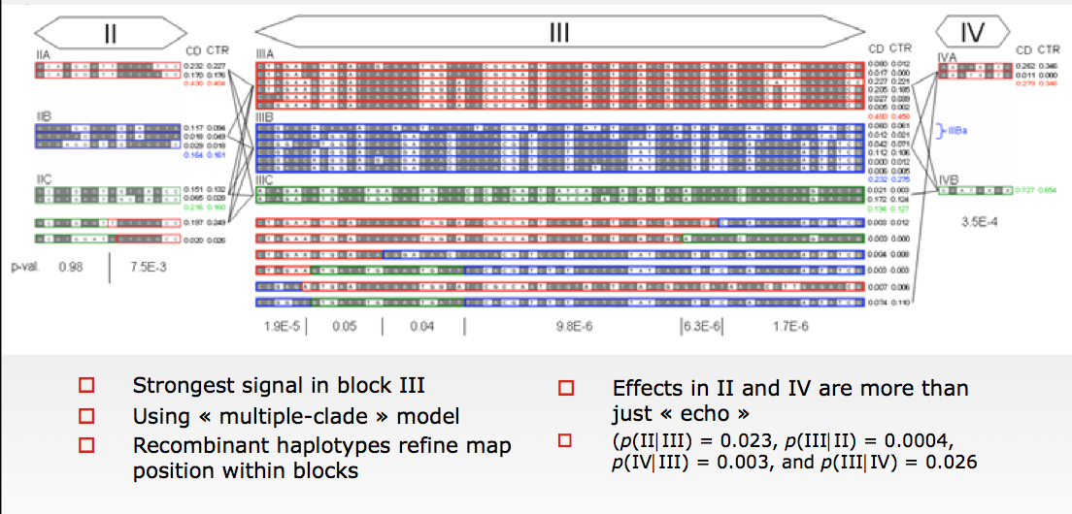
Haplotype Association Analysis

Slide 36
Final Notes on Haplotypes
Never impute case and control haplotypes separately
Haplotypes are sensitive to biases in genotype calling, for example missing values that result from poor genotype quality at the same site in multiple samples
Need strict data QC to avoid spurious associations

Slide 37
NGS-based Association Studies

Slide 38
NGS Association Studies
Use variants detected through exome or genome sequencing to look for trait associated loci
Capable of detecting rare or private variants
Often, focus is on coding regions
Locus heterogeneity
different ways to cause a similar effect on protein activity
Requires different strategies

Slide 39
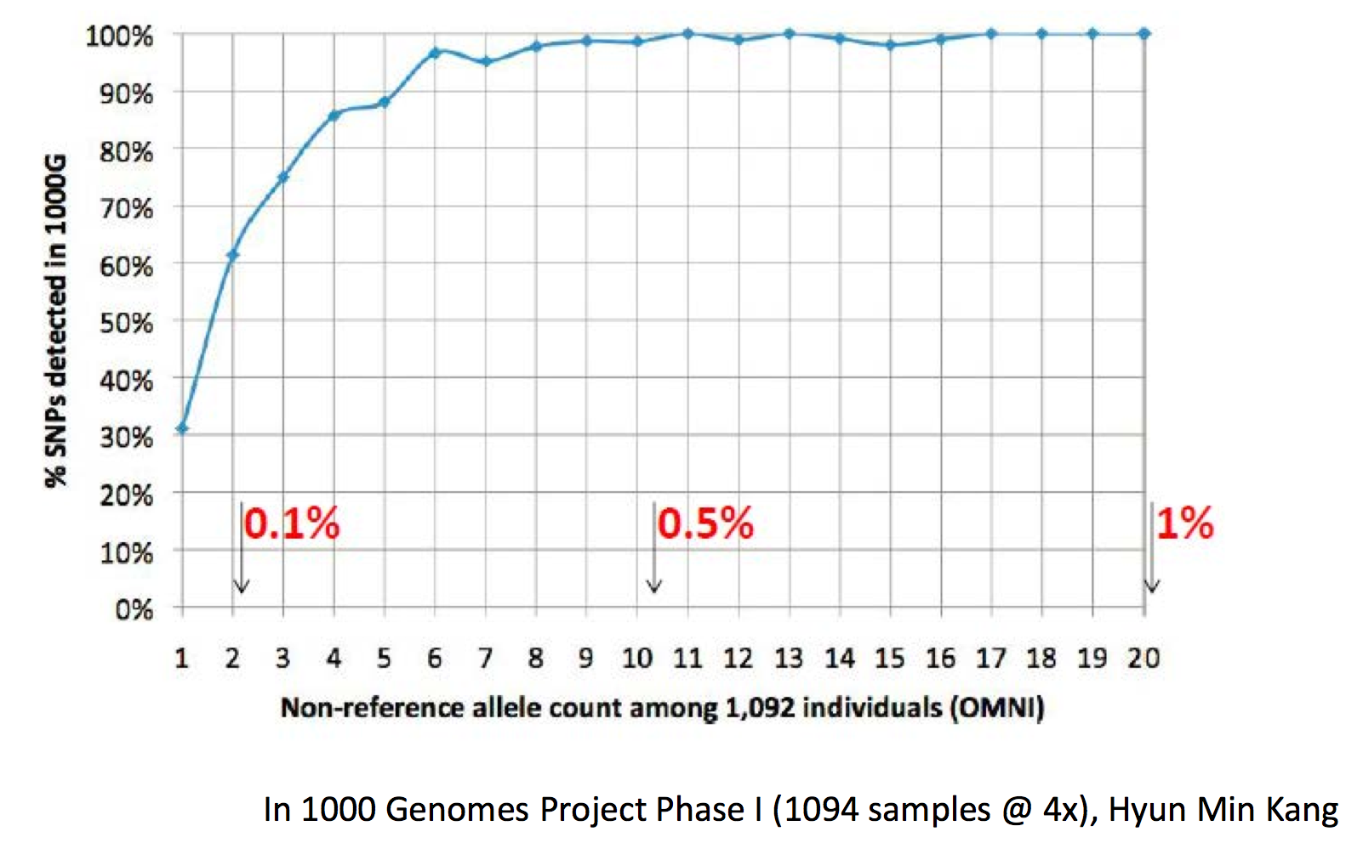
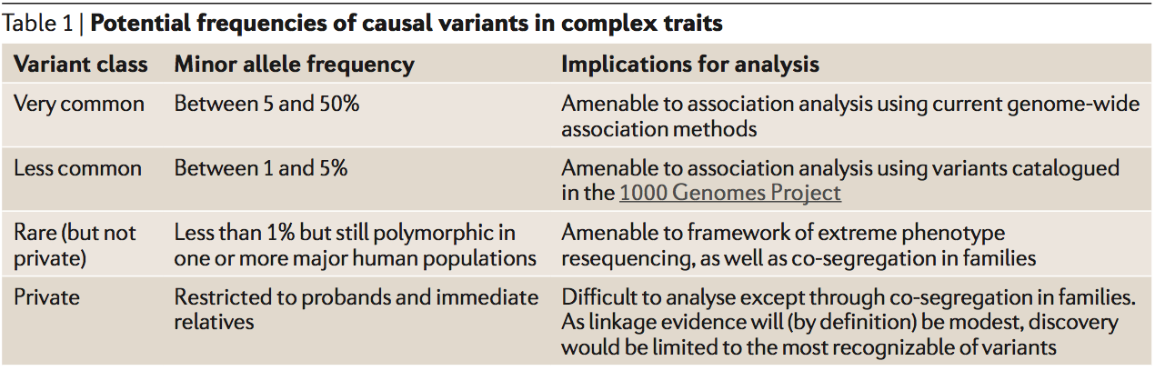
Variants Discovered as a Function of Frequecy

Slide 40
Why Study Rare Variants?
* COMPLETE GENETIC ARCHITECTURE OF EACH TRAIT
Are there additional susceptibility loci to be found?
What is the contribution of each identified locus to a trait?
Sequencing, imputation and new arrays describe variation more fully
Rare variants are plentiful and should identify new susceptibility loci
UNDERSTAND FUNCTION LINKING EACH LOCUS TO A TRAIT
More likely to be causal
Do we have new targets for therapy?
What happens in gene knockouts?
Use sequencing to find rare human “knockout” alleles
Good: Results may be more clear than for animal studies
Bad: Naturally occurring knockout alleles are extremely rare

Slide 41
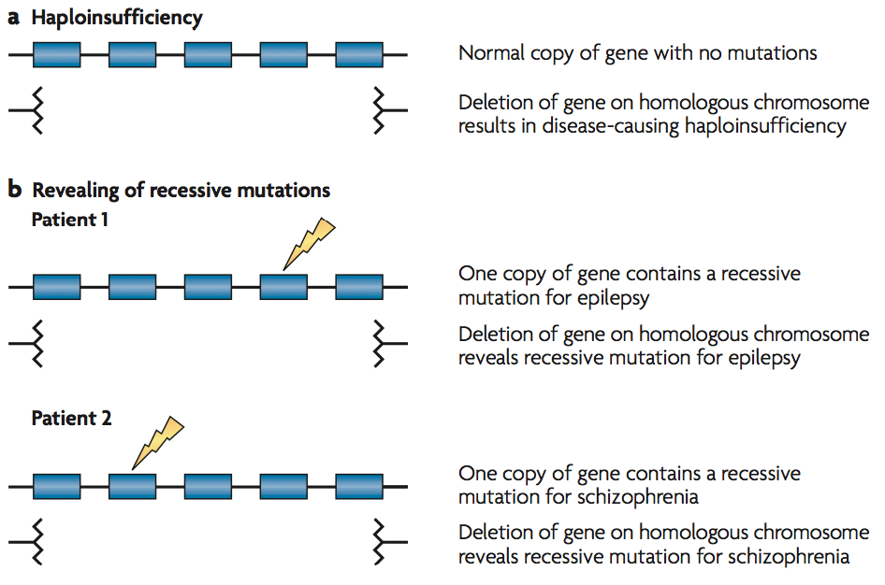
Why Study Rare Variants?
* COMPLETE GENETIC ARCHITECTURE OF EACH TRAIT
Are there additional susceptibility loci to be found?
What is the contribution of each identified locus to a trait?
Sequencing, imputation and new arrays describe variation more fully
Rare variants are plentiful and should identify new susceptibility loci
* UNDERSTAND FUNCTION LINKING EACH LOCUS TO A TRAIT
Do we have new targets for therapy?
What happens in gene knockouts?
Use sequencing to find rare human “knockout” alleles
Good: Results may be more clear than for animal studies
Bad: Naturally occurring knockout alleles are extremely rare

Slide 42
How Much Variation Might Rare Variants Explain?
All variation neutral, population size constant
MAF<0.1% variants explain 0.2% of heritability
MAF<1.0% variants explain 2.0% of heritability
MAF<5.0% variants explain 10% of heritability
Nonsynonymous frequency spectrum from 12,000 exomes
MAF<0.1% variants explain 3.6% of heritabilty
MAF<1.0% variants explain 10.6% of heritability
MAF<5.0% variants explain 22.7% of heritability
Assuming rare variants effect sizes are ~2x larger on average
Above estimates increase to about 8.6, 25.4 and 54.0%
Assuming rare variants effect sizes are ~3x larger on average
Above estimates increase to about 11.6, 34.1 and 72.6%

Slide 43
Challenge
Consider testing a variant with frequency of ~0.001 for association with a disease that has a ~10% prevalence
At a required significance level of 5x10⁻⁶
Corresponds to ~100,000 independent tests
Detecting a two-fold increase in risk, requires ~33,000 cases and ~33,000 controls
Detecting a three-fold increase in risk requires ~11,000 cases and ~11,000 controls
Power depends on both frequency and effect size!

Slide 44
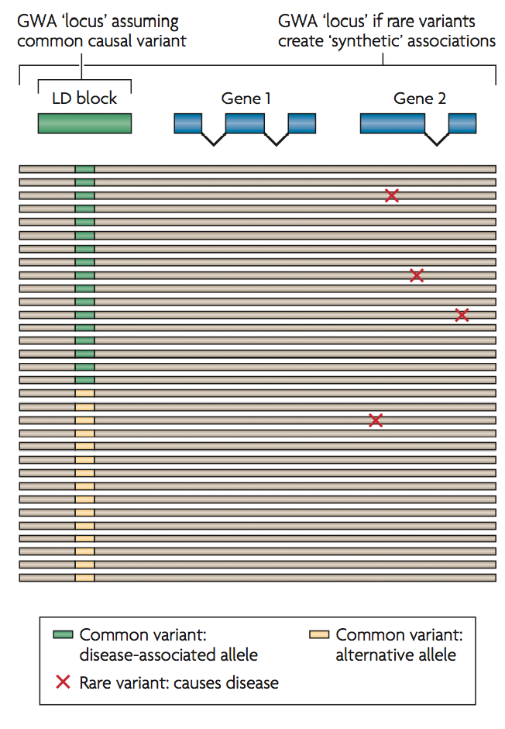
Synthetic Associations
Can sometimes detect rare variants on the basis of common variation
Occurs when rare variant occurs more frequently on a particular haplotype

Slide 45
Approaches to Study Rare Coding Variants
Burden Tests
Weighted Burden Tests
Allowing for Direction of Effect

Slide 46
Collapsing Rare Variants
Instead of testing rare variants individually, group variants likely to have similar function
Group by region – often the region is a gene
Can also be a set of related genes
Score presence or absence of rare variants per individual
Use rare variant score to predict trait values
If all variants are causal, leads to large increase in power
In practice, success depends on:
Number of associated variants,
Number of neutral variants diluting signals
Whether direction of effect is consistent within gene

Slide 47
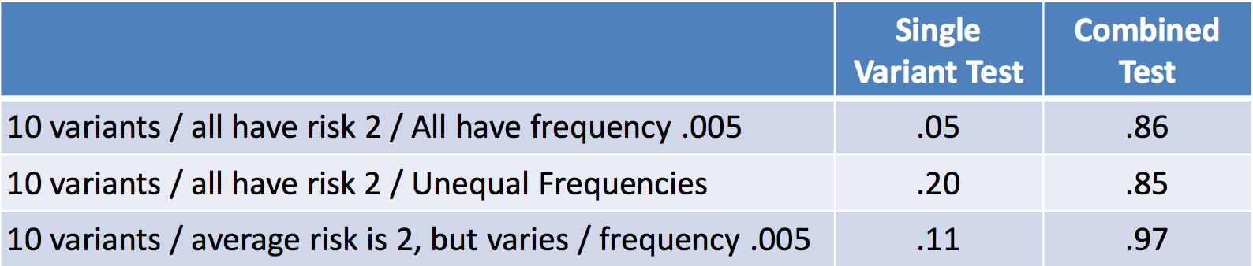
Burden vs. Single Variant Tests
Power tabulated in collections of simulated data, for 250 cases and 250 controls
Combining variants can greatly increase power
Currently, appropriately combining variants is expected to be key feature of rare variant studies.
Li and Leal (2008) Am J Hum Genet 83:311-321

Slide 48
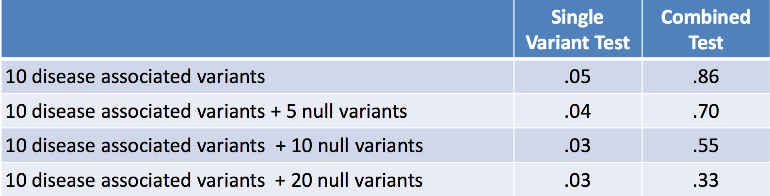
Impact of Non-disease Alleles
Power estimates based on simulated data
Including non-disease variants reduces power
Power loss is manageable, combined test remains preferable to single marker tests

Slide 49
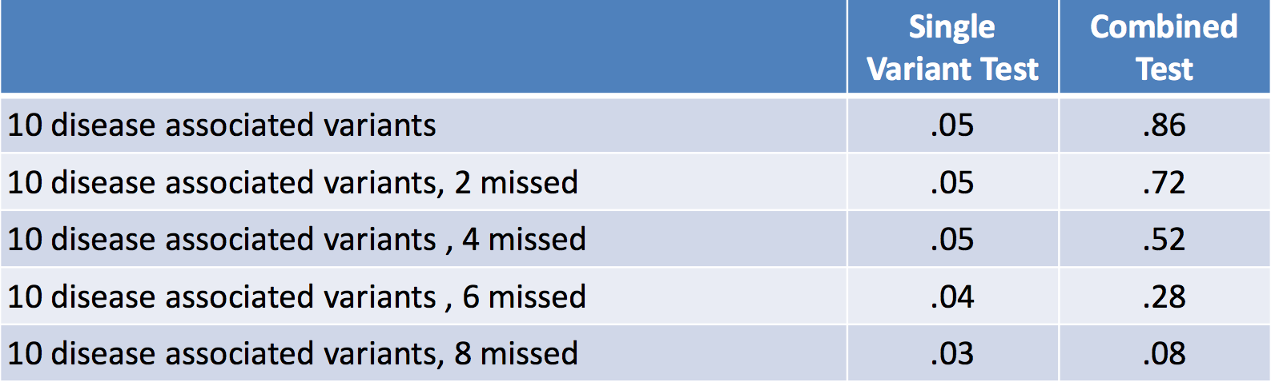
Impact of Missing Disease Alleles
Power estimates again based on simulated data
Missing disease associated variants loses power

Slide 50
Refining Rare Variant Tests
The original Li and Leal (2008) test simply “collapses” rare variants into one allele
Multiple refinements have been proposed since…
Counting the number of rare variants per individual
Weighting rare variants according to frequency
Weighting rare variants according to function
Including imputed variants in the analysis
Each of these methods may improve power, but few practical examples provide guidance

Slide 51
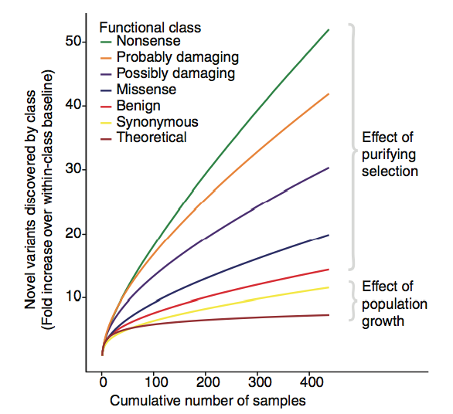
Refinement based on function

Slide 52
Burden Test Methods
Combined Multivariate and Collapsing (CMC)
Jointly assesses common and rare variation in a regression model
Presence of a rare variant is included as a binary covariate
Weighted-sum statistic (WSS)
score is the sum of alternate alleles weighted by the inverse of the binomial variance
Kernel-based adaptive cluster (KBAC)
Similar to WSS but weights alternative alleles based on function
Sequence kernel association test (SKAT)
Variants allowed to have opposite effects on the trait
Variable Threshold (VT)
Groups rare variants based on allele frequencies
Burden Or Mutation Position (BOMP)
Sliding window over gene – doesn’t assume that variants at any position in the gene are equally likely to contribute to a phenotype
Variant Annotation, Analysis, and Search Tool (VAAST)
Cumulative minor-allele test (CMAT)
…

Slide 53
Weights
Use computational algorithms to prioritize functional variants
Based on conservation
Based on biochemical properties
Many methods available (SIFT, PolyPhen, VEST, …)
Frequency is an independent predictor of functional consequence.

Slide 54
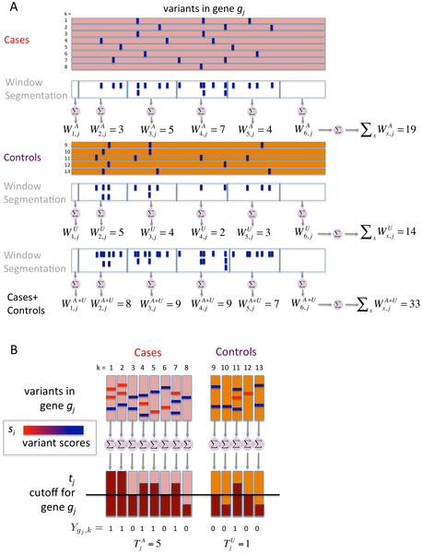

Figure 8. Components of BOMP Hybrid Likelihood Model compared.
Burden statistic that looks for an unexpected enrichment of variants in a region of a gene in cases versus controls
Burden statistic that allows functional weighting of variants
Chen YC, Carter H, Parla J, Kramer M, Goes FS, et al. (2013) A Hybrid Likelihood Model for Sequence-Based Disease Association Studies. PLoS Genet 9(1): e1003224. doi:10.1371/journal.pgen.1003224
http://127.0.0.1:8081/plosgenetics/article?id=info:doi/10.1371/journal.pgen.1003224

Slide 56
Exercises
Estimating heritability
Ipython notebook
Estimating variance explained with GCTA
- Using hapmap1 data
- Instructions in http://chianti.ucsd.edu/~hcarter/biom262/GCTA_experiment.txt

